Slide 1
Speech Emotion Recognition with gender prediction using CNN
By
ANIL KUMAR MAKKENA

Slide 2
INTRODUCTION
In this field several systems are proposed for recognizing emotional state of human from speaker’s voice or speech signal. Some universal emotions include anger, happiness, sadness, surprise, neutral, disgust, fearful, stressed etc.
Emotions cannot be estimated with text alone as irony, humor, cadence etc. are important components of a speech. So, text has a limited capacity in conveying emotions.
There is various work in sentiment analysis with text and speech but this project deals with the identification of mood in a non-discrete way. The traditional method of prediction emotion where labeling a certain number of discrete emotions is obviously a method of classification using various learning techniques.
As an essential way of human emotional behavior understanding, speech emotion recognition (SER) has attracted a great deal of attention in human-centered signal processing.
The key to speech emotion recognition is extraction of speech emotion features and the convolution neural network is used as the feature extractor to extract the speech emotion feature from the normalized spectrogram. Accuracy in SER heavily depends on finding good affect- related, discriminative features.
In this paper, we propose to learn affect-salient features for SER using convolutional neural networks (CNN).

Slide 3
Objective
This paper mainly focuses on neural network-based Machine Learning system capable of deriving the emotion of a person through the audio of his or her voice. The primary research question being:
1. How can a neural network, be used for interpreting the emotion of Speech?
2. A literature survey clarifies the role of Speech emotion recognition and types of networks suitable for Automated Classification.
3. how the neural network under consideration is structured and how it is trained?
4. how the final model performs which is followed by conclusion?

Slide 4
LITERATURE REVIEW
(1) Origlia et al. used a maximum, minimum, mean, and standard deviation of pitch and energy related features to form a 31-dimensional prosodic feature, and the recognition was the approximately 60% in multilingual emotional corpus.
(2) Hinton et al. proposed a fast-learning algorithm for the Restricted Boltzmann Machine-the contrast divergence algorithm. The pre-training of the restricted Boltzmann machine is carried out by using the comparative divergence algorithm. DBN is widely used in speech recognition, Deng et al. analyzed the important role of the two stages of deep neural network training (pre-training and fine tuning) in speech recognition. They use DBN to extract features, and then use the Hidden Markov Model (HMM) to identify speech.
(3) In another study, Sainath et al. , proposed a Convolutional, Long Short-Term Memory Deep Neural Network (CLDNN) model for a speech recognition task, that is able to reduce temporal and frequency variations. Dai et al. proposed an end-to-end very deep neural network to extract features to learn acoustic models.

Slide 5
Dataset
We choose RAVDESS dataset and it contains 7356 files which includes songs and speech. And speech consists of 1440 files. Each audio file was rated on a scale of 10 on intensity, emotional validity, and genuineness. The database contains 12 females, 12 male speakers, in a neutral American accent. The emotion in the speech includes surprise, happy, calm, fearful, sad, disgust and angry.
Link:
Surrey Audio-Visual Expressed Emotion (SAVEE) is an acted English dataset. The SAVEE dataset consists of 480 British English utterances. The recordings were done by four male speakers DC, JE, JK, and KL. It consists of 15 sentences for each of the seven different emotions, anger, fear, happiness, disgust, sadness, surprise, and neutral. Each emotion has 60 utterances except neutral with 120 utterances.
Link: http://kahlan.eps.surrey.ac.uk/savee/Download.html
Among the many resources currently available, the Ryerson Audio-Visual Database of Emotional Speech and Song (RAVDESS) Database met these requirements. The speech part of RAVDESS consists in two different English sentences (1: “Kids are talking by the door”, and 2: “Dogs are sitting by the door”) pronounced by 24 different actors (12 male, 12 female).
https://smartlaboratory.org/ravdess/

Slide 6
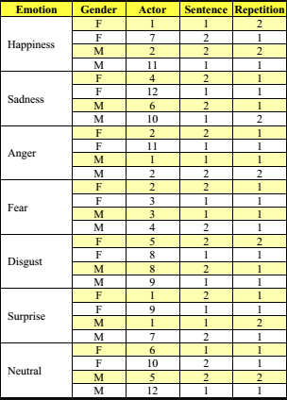
Dataset(Cont.)
RAVDESS Dataset Overview

Slide 7
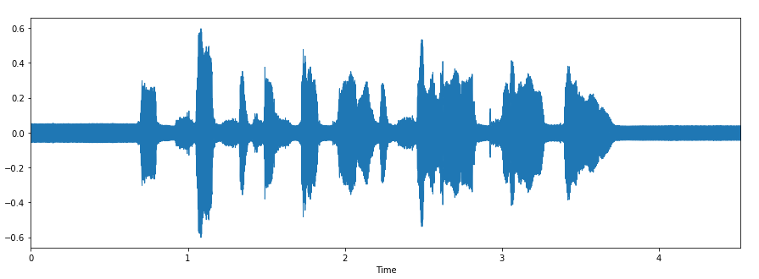
DATA PROCESSING
RAVDESS dataset has the information of each audio's class in its name. we processed the audio and appended to its respective classes. Extracted MFCC floating values and transformed into feature vector and classes.
We used the landmark of SAVEE dataset and tagged value of valence and arousal for RAVDESS dataset resulting in a mapping like this which is used for one hot encoding of two 3-class vector (high/mid/low). The following calculation is rounded to the nearest integer (ceiling) and used just to extrapolate to a slightly larger scale.
Original RAVDESS speech items are sampled at 48 kHz.

Slide 8
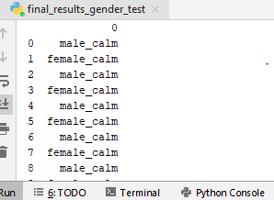
DATA PROCESSING(CONT.)
The sequences of operations performed to limit their audio bandwidth to standard telephony bandwidths (full band, super wideband, wideband, narrowband MSIN and narrowband IRS). These sequences of operations are in line with what can be found in processing plans used to select and characterize speech coding standards. They also condition audio signals in much the same way as a speech codec would. In addition to being bandlimited, all test items are normalized at the P.56 level of −26 dBovl (dB relative to overload) and played at the 48 kHz sampling rate.

Slide 9
Tools and package
Tools used to implement the model is JetBrains Pycharm 2019 using the python programming language. The packages are listed below:
Keras: is used for audio processing and creating the Deep Learning model
Sklearn: is used to split the dataset into train and test set. Also, for creating Machine Learning models
Matplotlib: plotting the MFCC
Pandas and numpy: for data manipulation
Open-cv2: is used to extract the audio features in the form of numbers.
OS: is used to locate the files
Librosa: uses soundfile and audioread to load audio files.

Slide 10
MODELS AND IMPLEMENTATION
The proposed framework endeavors to use a discriminative Convolution Neural Networks for feature learning schemes utilizing spectrograms produced from speech signals. The stride CNN architecture will have input layers, convolutional layers, a flatten layer, and fully connected layers followed by a SoftMax classifier. The spectrograms will be put into use as they tend to hold rich information. Also, extraction and application of such information when transforming the audio speech signal to text or phonemes are highly unlikely. This capability lets the spectrogram enhance the recognition of emotion. Therefore, the primary idea is to study high-level discriminative features from speech signals, making CNN architecture highly imperative.

Slide 11
CONVOLUTIONAL NEURAL NETWORK
A CNN architecture can be built by stacking multiple different layers.
The building blocks of CNN are some distinct types of layers such as a convolutional layer, pooling layer, ReLU layer, loss layer, LSTM layer, and fully connected layer.
The convolution layer and the pooling layer are the core layers of CNN. The convolution layer plays the role of feature extractors and learns the local features which restrict the receptive fields of the hidden layers to be local.
When a convolution kernel moves along the input to the convolution, it forms a feature map. Therefore, the number of features maps a convolutional layer has is equal to the number of convolution kernels.
The pooling layer, which makes the features robust against noises and distortion, performs the non-linear down-sampling function and reduces the resolution of the features.

Slide 12
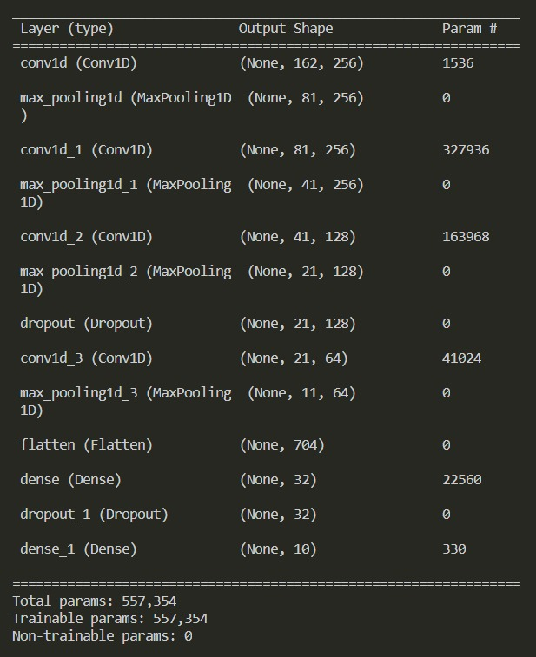

Slide 13
CNN IMPLEMENTATION
Preparing the Data to feed into the CNN model
Splitting the Dataset into training and testing dataset in 8:2 ratio
Pushing the training and testing set as Image from the dataset
4 hidden layer of CNN model is used to train the model
Testing the model
Checking the Accuracy

Slide 14
TRAINING THE MODEL
Test subjects are first asked to listen at least once to every test item, after these items have been processed in the baseline fullband condition. The goal of this phase is to familiarize subjects with the structure and content of test stimuli, and with the way emotions are acted. This phase typically takes less than 5 minutes to complete.
At first glance, this training phase could introduce a bias in the study by making signals in the full band condition easier to recognize for the subjects. But this corresponds to the real-life situation where training is done on acoustic, thus fullband, signals.
All our experiments have been conducted on a device powered by a Nvidia GeForce GTX 1050Ti GPU with 8 GB of RAM.
This model was trained using 700 epochs on a 16-batch size on each pass.

Slide 15
Testing the Model
The test items processed in each of the five bandwidth conditions are presented in a randomized order to the subjects.
These can listen to an item as many times as they want before taking a decision regarding the emotion they have recognized. This phase typically takes between 15 and 20 minutes to complete.
Without them knowing it, the software also recorded the number of times subjects listened to every stimulus before planning.
Passing the audio file as the input into the trained model and the model will predict the gender and the emotion of that speech.

Slide 16
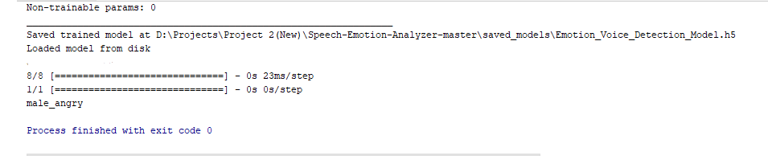
RESULT

Slide 17
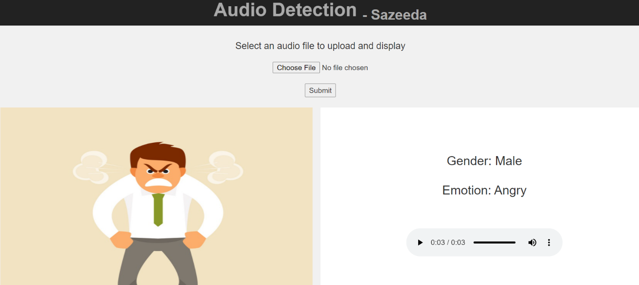
Final web application:
The model which is processed and built is exported into h5 file using FLASK application (Template) where we will be creating a web application. The file is read and the audio file is selected then the service call will take audio file as input and it sends the file for preprocessing, the processed output audio file is sent as input for .h5 file . The output from this web application will be shown in terms of whether the audio is male or female and also it shows the emotion of audio file with a image.

Slide 18
CONCLUSION AND FUTURE WORKS
We can clearly see how the accuracy hovers around 80% for the test set which does not give much assurance on the prediction of exact emotion done using discrete model. The learning graph clearly states that even after 100 more epochs the test performance remains constant. We implemented our proposal of a 1D quadrant predictor CNN model. The number of classes in the dimensional model reduced the class to 4, this is because the 1D coordinate system has 4 quadrants. But we can see this clearly gives a better idea of where the emotion attached to a speech fits in the dimensions of emotion.
Experimental results on public emotional speech databases show superior performance of the learned features with respect to speaker variation, environment distortion, and language variation when compared with several well-established feature representations. we present an effective approach to learn representations for emotional utterances.
In the future, we plan to extend the proposed method in this paper and evaluate its performance on naturalistic speech data on the real-time basis.

Slide 19

Thank you

Slide 20
REFERENCE
1. Jiang Haihua and Hu Bin, "Recognition of Mandarin Speech and Emotion Based on PCA and SVM [J]", Computer Science, vol. 42, no. 11, pp. 270-273, 2015.
2. D Yu, L Deng and G. Dahl, Roles of pretraining and fine_tuning in context_dependent dbn_hmms for real_world speech recognition[OL], 2014.
3. S. Dieleman and B. Schrauwen, "End-to-end learning for music audio", ICASSP. IEEE, pp. 6964-6968, 2014.

